Slide 1
Events: Mouse, Keyboard

Slide 2
Event-Driven Programming
Procedural programming is executed in procedural order.
In event-driven programming, code is executed upon activation of events.

Slide 3
Events
An event can be defined as a type of signal to the program that something has happened.
The event is generated by external user actions such as mouse movements, mouse button clicks, and keystrokes, or by the operating system, such as a timer.

Slide 4
Event Information
id: A number that identifies the event.
target: The source component upon which the event occurred.
arg: Additional information about the source components.
x, y coordinates: The mouse pointer location when a mouse movement event occurred.
clickCount: The number of consecutive clicks for the
mouse events. For other events, it is zero.
when: The time stamp of the event.
key: The key that was pressed or released.

Slide 5
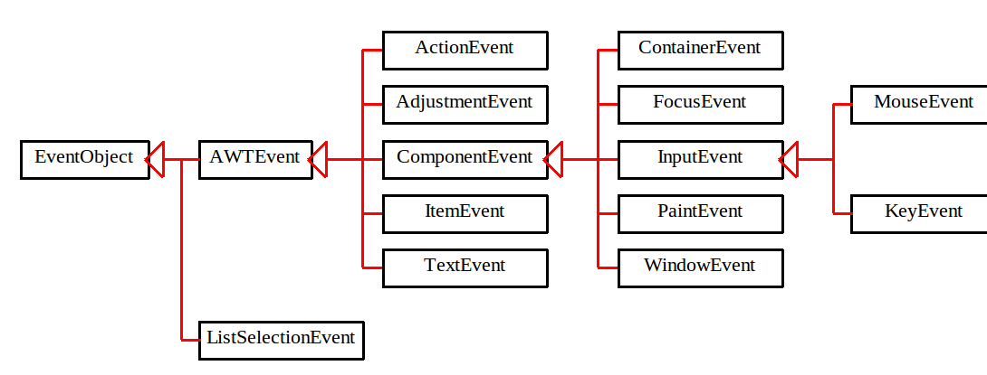
Event Classes

Slide 6
Selected User Actions
Source Event Type
User Action Object Generated
Clicked on a button JButton ActionEvent
Changed text JTextComponent TextEvent
Double-clicked on a list item JList ActionEvent
Selected or deselected an item JList ItemEvent
with a single click
Selected or deselected an item JComboBox ItemEvent

Slide 7
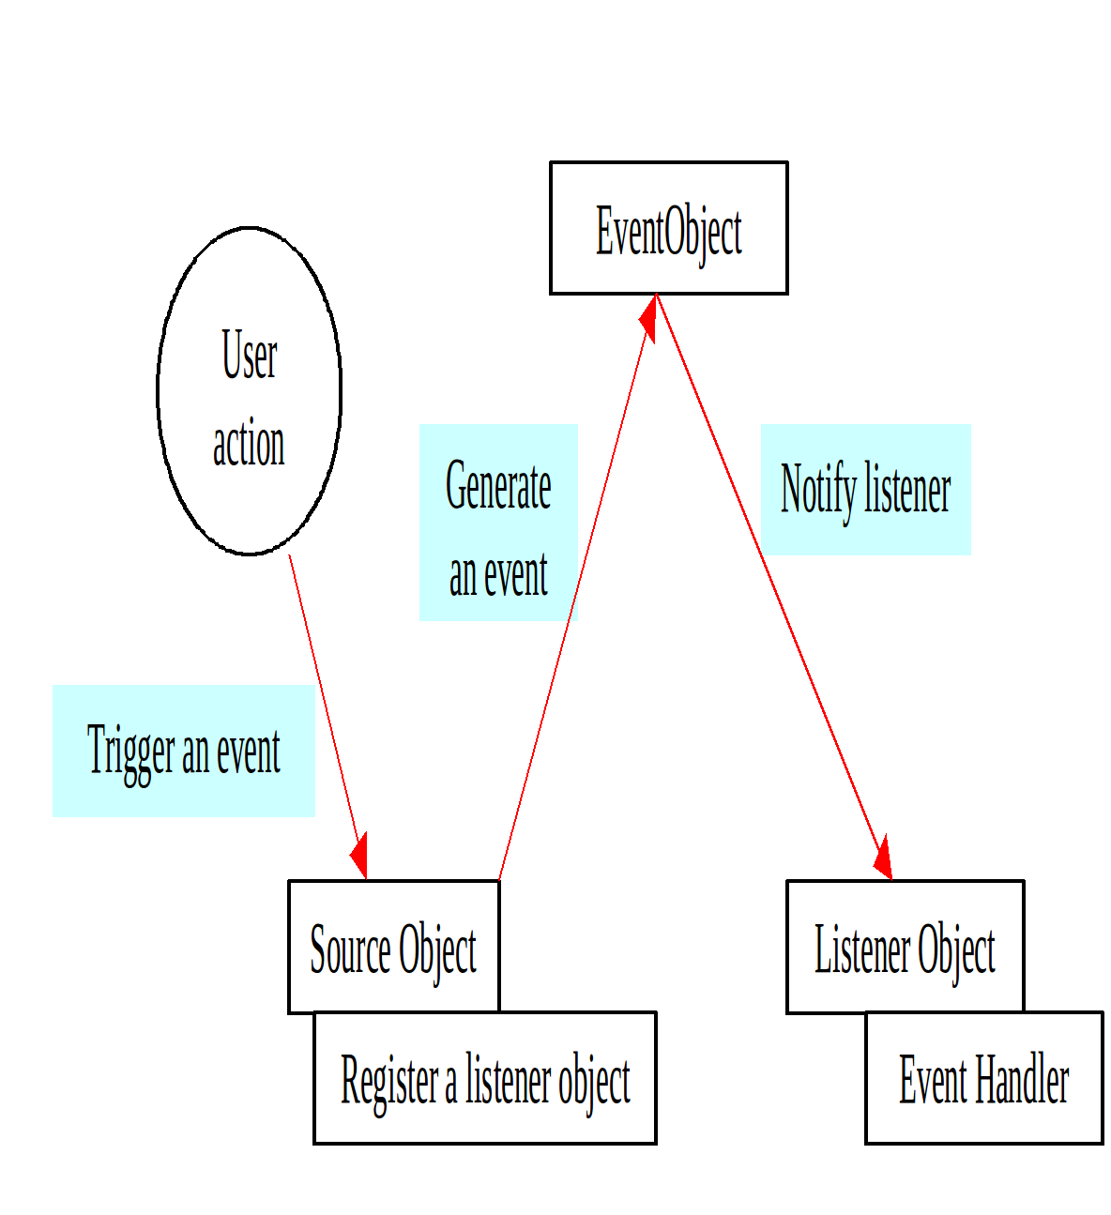
The Delegation Model

Slide 8
Selected Event Handlers
Event Class Listener Interface Listener Methods (Handlers)
ActionEvent ActionListener actionPerformed(ActionEvent)
ItemEvent ItemListener itemStateChanged(ItemEvent)
WindowEvent WindowListener windowClosing(WindowEvent)
windowOpened(WindowEvent)
windowIconified(WindowEvent)
windowDeiconified(WindowEvent)
windowClosed(WindowEvent)
windowActivated(WindowEvent)
windowDeactivated(WindowEvent)
ContainerEvent ContainerListener componentAdded(ContainerEvent)
componentRemoved(ContainerEvent)

Slide 9
Listeners
Listener methods take a corresponding type of event as an argument.
Event objects have useful methods. For example, getSource returns the object that produced this event.
A MouseEvent has methods getX, getY.
15-<number>
Notes:
You have to cast the object returned by getSource into the type that caused event. For example
JButton btn = (JButton).getSource();
You can attach the same listener to different types of components; then getSource is not very useful.

Slide 10
Mouse Events
Mouse events are captured by an object which is a MouseListener and possibly a MouseMotionListener.
A mouse listener is usually attached to a JPanel component.
It is not uncommon for a panel to serve as its own mouse listener:
addMouseListener(this);
addMouseMotionListener(this); // optional

Slide 11
Mouse Events (cont’d)
Mouse listener methods receive a MouseEvent object as a parameter.
A mouse event can provide the coordinates of the event and other information:
public void mousePressed(MouseEvent e)
{
int x = e.getX();
int y = e.getY();
int clicks = e.getClickCount();
}

Slide 12
Mouse Events (cont’d)
The MouseMotionListener interface adds two methods:
  void mouseMoved (MouseEvent e)
  void mouseDragged (MouseEvent e)
These methods are usually used together with MouseListener methods (i.e., a class implements both interfaces).
Called when the mouse has moved with a button held down

Slide 13
Keyboard Events
Keyboard events are captured by an object which is a KeyListener.
A key listener object must first obtain keyboard “focus.” This is done by calling the component’s requestFocus method.
If keys are used for moving objects (as in a drawing program), the “canvas” panel may serve as its own key listener:
addKeyListener(this);

Slide 14
Keyboard Events (cont’d)
The KeyListener interface defines three methods:
  void keyPressed (KeyEvent e)
  void keyReleased (KeyEvent e)
  void keyTyped (KeyEvent e)
One key pressed and released causes several calls.
Notes:
For example, typing Shift+A, causes five calls: Shift pressed, ‘a’ pressed, ‘a’ released, Shift released, ‘A’ typed.

Slide 15
Keyboard Events (cont’d)
Use keyTyped to capture character keys (i.e., keys that correspond to printable characters).
e.getKeyChar() returns a char, the typed character:
public void keyTyped (KeyEvent e)
{
char ch = e.getKeyChar();
if (ch == ‘A’)
...
}

Slide 16
Mouse Events (cont’d)
The MouseListener interface defines five methods:
  void mousePressed (MouseEvent e)
  void mouseReleased (MouseEvent e)
  void mouseClicked (MouseEvent e)
  void mouseEntered (MouseEvent e)
  void mouseExited (MouseEvent e)
One click and release causes several calls. Using only mouseReleased is usually a safe bet.
Called when the mouse cursor enters/exits component’s visible area
Notes:
mouseClicked checks that the button was pressed and released in the same place, which may result in missed clicks.

Slide 17
Keyboard Events (cont’d)
Use keyPressed or keyReleased to handle “action” keys, such as cursor keys, <Enter>, function keys, and so on.
e.getKeyCode() returns an int, the key’s “virtual code.”
The KeyEvent class defines constants for numerous virtual keys. For example:
VK_LEFT, VK_RIGHT, VK_UP, VK_DOWN
VK_HOME, VK_END, VK_PAGE_UP, ...etc.
Cursor keys
Home, etc.

Slide 18
Keyboard Events (cont’d)
e.isShiftDown(), e.isControlDown(), e.isAltDown() return the status of the respective modifier keys.
e.getModifiers() returns a bit pattern that represents the status of all modifier keys.
KeyEvent defines “mask” constants CTRL_MASK, ALT_MASK, SHIFT_MASK, and so on.

Slide 19
Event Handling Strategies:
Pros and Cons
Separate Listener
  Advantages
    Can extend adapter and thus ignore unused methods
    Separate class easier to manage
  Disadvantage
    Need extra step to call methods in main window
Main window that implements interface
  Advantage
    No extra steps needed to call methods in main window
  Disadvantage
    Must implement methods you might not care about

Slide 20
Event Handling Strategies:
Pros and Cons, cont.
Named inner class
  Advantages
    Can extend adapter and thus ignore unused methods
    No extra steps needed to call methods in main window
  Disadvantage
    A bit harder to understand
Anonymous inner class
  Advantages
    Same as named inner classes
    Even shorter
  Disadvantage
    Much harder to understand

Slide 21
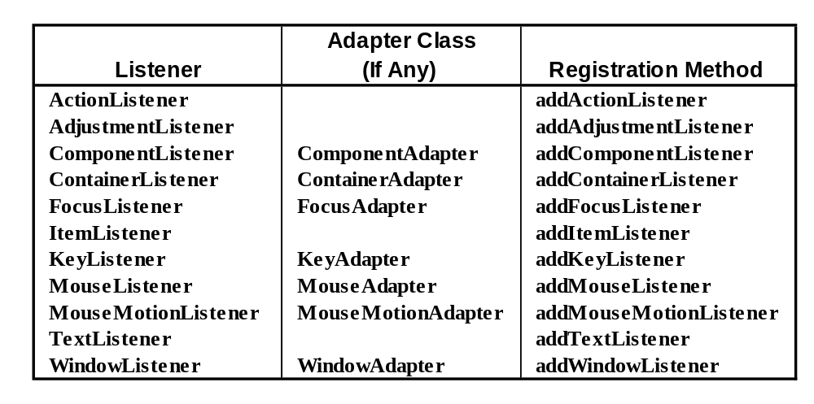
Standard AWT Event Listeners
(Summary)
Why no adapter class?

Slide 22
Standard AWT Event Listeners
(Details)
ActionListener
  Handles buttons and a few other actions
    actionPerformed(ActionEvent event)
AdjustmentListener
  Applies to scrolling
    adjustmentValueChanged(AdjustmentEvent event)
ComponentListener
  Handles moving/resizing/hiding GUI objects
    componentResized(ComponentEvent event)
    componentMoved (ComponentEvent event)
    componentShown(ComponentEvent event)
    componentHidden(ComponentEvent event)

Slide 23
Standard AWT Event Listeners
(Details Continued)
ContainerListener
  Triggered when window adds/removes GUI controls
    componentAdded(ContainerEvent event)
    componentRemoved(ContainerEvent event)
FocusListener
  Detects when controls get/lose keyboard focus
    focusGained(FocusEvent event)
    focusLost(FocusEvent event)

Slide 24
Standard AWT Event Listeners
(Details Continued)
ItemListener
  Handles selections in lists, checkboxes, etc.
    itemStateChanged(ItemEvent event)
KeyListener
  Detects keyboard events
    keyPressed(KeyEvent event) -- any key pressed down
    keyReleased(KeyEvent event) -- any key released
    keyTyped(KeyEvent event) -- key for printable char released

Slide 25
Standard AWT Event Listeners
(Details Continued)
MouseListener
  Applies to basic mouse events
    mouseEntered(MouseEvent event)
    mouseExited(MouseEvent event)
    mousePressed(MouseEvent event)
    mouseReleased(MouseEvent event)
    mouseClicked(MouseEvent event) -- Release without drag
      Applies on release if no movement since press
MouseMotionListener
  Handles mouse movement
    mouseMoved(MouseEvent event)
    mouseDragged(MouseEvent event)

Slide 26
GridBagLayout
Behavior
  Divides the window into grids, without requiring the components to be the same size
    About three times more flexible than the other standard layout managers, but nine times harder to use
  Each component managed by a grid bag layout is associated with an instance of GridBagConstraints
    The GridBagConstraints specifies:
      How the component is laid out in the display area
      In which cell the component starts and ends
      How the component stretches when extra room is available
      Alignment in cells

Slide 27
GridBagLayout: Basic Steps
Set the layout, saving a reference to it
GridBagLayout layout = new GridBagLayout();
setLayout(layout);
Allocate a GridBagConstraints object
GridBagConstraints constraints =
new GridBagConstraints();
Set up the GridBagConstraints for
component 1
constraints.gridx = x1;
constraints.gridy = y1;
constraints.gridwidth = width1;
constraints.gridheight = height1;
Add component 1 to the window, including constraints
add(component1, constraints);
Repeat the last two steps for each remaining component

Slide 28
GridBagConstraints
Copied when component added to window
Thus, can reuse the GridBagConstraints
GridBagConstraints constraints = new GridBagConstraints();
constraints.gridx = x1;
constraints.gridy = y1;
constraints.gridwidth = width1;
constraints.gridheight = height1;
add(component1, constraints);
constraints.gridx = x1;
constraints.gridy = y1;
add(component2, constraints);

Slide 29
GridBagConstraints Fields
gridx, gridy
  Specifies the top-left corner of the component
  Upper left of grid is located at (gridx, gridy)=(0,0)
  Set to GridBagConstraints.RELATIVE to
  auto-increment row/column
GridBagConstraints constraints = new GridBagConstraints();
constraints.gridx = GridBagConstraints.RELATIVE;
container.add(new Button("one"), constraints);
container.add(new Button("two"), constraints);

Slide 30
GridBagConstraints Fields
gridwidth, gridheight
  Specifies the number of columns and rows the Component occupies
  constraints.gridwidth = 3;
  GridBagConstraints.REMAINDER lets the component take up the remainder of the row/column
weightx, weighty
  Specifies how much the cell will stretch in the x or y direction if space is left over
  constraints.weightx = 3.0;
  Constraint affects the cell, not the component (use fill)
  Use a value of 0.0 for no expansion in a direction
  Values are relative, not absolute

Slide 31
GridBagConstraints Fields (Continued)
fill
  Specifies what to do to an element that is smaller than the cell size
  constraints.fill = GridBagConstraints.VERTICAL;
  The size of row/column is determined by the widest/tallest element in it
  Can be NONE, HORIZONTAL, VERTICAL, or BOTH
anchor
  If the fill is set to GridBagConstraints.NONE, then the anchor field determines where the component is placed
  constraints.anchor = GridBagConstraints.NORTHEAST;
  Can be NORTH, EAST, SOUTH, WEST, NORTHEAST, NORTHWEST, SOUTHEAST, or SOUTHWEST

Slide 32
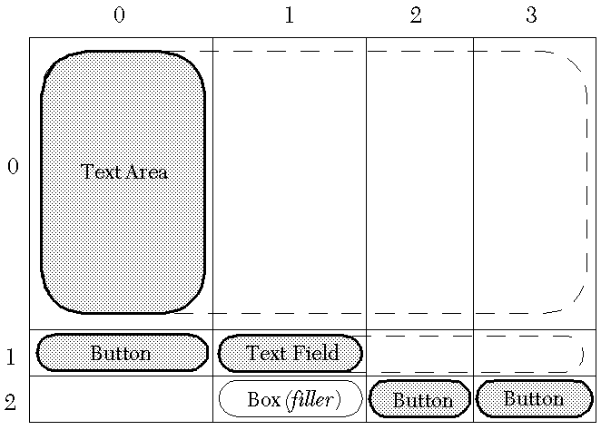
GridBagLayout: Example

Slide 33
GridBagLayout, Example
public GridBagTest() {
setLayout(new GridBagLayout());
textArea = new JTextArea(12, 40);
// 12 rows, 40 cols
bSaveAs = new JButton("Save As");
fileField = new JTextField("C:\\Document.txt");
bOk = new JButton("OK");
bExit = new JButton("Exit");
GridBagConstraints c = new GridBagConstraints();
// Text Area.
c.gridx = 0;
c.gridy = 0;
c.gridwidth = GridBagConstraints.REMAINDER;
c.gridheight = 1;
c.weightx = 1.0;
c.weighty = 1.0;
c.fill = GridBagConstraints.BOTH;
c.insets = new Insets(2,2,2,2); //t,l,b,r
add(textArea, c);
...
// Save As Button.
c.gridx = 0;
c.gridy = 1;
c.gridwidth = 1;
c.gridheight = 1;
c.weightx = 0.0;
c.weighty = 0.0;
c.fill = GridBagConstraints.VERTICAL;
add(bSaveAs,c);
// Filename Input (Textfield).
c.gridx = 1;
c.gridwidth = GridBagConstraints.REMAINDER;
c.gridheight = 1;
c.weightx = 1.0;
c.weighty = 0.0;
c.fill = GridBagConstraints.BOTH;
add(fileField,c);
...

Slide 34
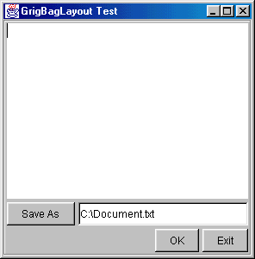
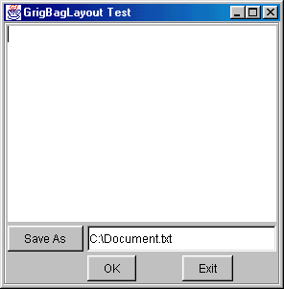
GridBagLayout, Example
// Exit Button.
c.gridx = 3;
c.gridwidth = 1;
c.gridheight = 1;
c.weightx = 0.0;
c.weighty = 0.0;
c.fill = GridBagConstraints.NONE;
add(bExit,c);
// Filler so Column 1 has nonzero width.
Component filler =
Box.createRigidArea(new Dimension(1,1));
c.gridx = 1;
c.weightx = 1.0;
add(filler,c);
...
}
With / Without Box filler at (2,1)

